Slide 1

E-Commerce Site
Automated Testing
nFocus
PRESENTED BY
Dharmanshi Sangani
Notes:
My name is Dharmanshi Sangani, and I’m excited to share our project on automated testing for an e-commerce site using Playwright.

Slide 2

Agenda
Project Outline
Why Playwright?
Implementation & Architecture
Allure Reporting
Demo
Notes:
"Here’s what we’ll cover today:
First, we’ll discuss the Implementation and Architecture of the testing framework.
Next, I’ll explain Why Playwright was chosen as the tool for this project.
We’ll then look at Allure Reporting, a powerful way to analyze and present test results.
Finally, I’ll guide you through a quick Demo to see it all in action. By the end of this presentation, you’ll have a clear understanding of how these components work together to create an effective automated testing solution."

Slide 3
Project Outline
The test will login to an e-commerce site as a registered user, purchase an item of clothing, apply a discount code.
Check the total is correct after the discount & shipping is applied.
Apply Coupon for 15% off
The test will login to an e-commerce site as a registered user, purchase an item of clothing and go through checkout.
It will capture the order number and check the order is also present in the ‘My Orders’ section of the site.
Order is submitted successfully
Notes:
"This project focuses on automating key workflows of an e-commerce website. The first test is the Coupon Test. Here, the test logs in as a registered user, purchases a clothing item, applies a discount code, and verifies that the total price reflects the discount and shipping correctly. The second test is the Order Submission Test. In this scenario, the test logs in, completes a purchase, captures the order number, and confirms that it appears in the 'My Orders' section. These tests ensure the accuracy of key functionalities, mimicking real user interactions."

Slide 4
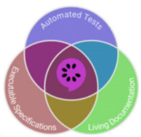
Playwright Test
Modern framework for end-to-end web testing
TOOLS AND FRAMEWORKS
TypeScript
Strongly-typed superset of JavaScript
Visual Studio Code
Development Environment and Debugging
Playwright Test Runner & Allure Reporting
Comprehensive test reporting and analysis
Notes:
"To achieve these goals, we leveraged a range of tools and frameworks:
Playwright, a modern framework for end-to-end web testing, was our main tool.
We used TypeScript, a strongly-typed superset of JavaScript, for better reliability and maintainability in coding.
Development and debugging were done in Visual Studio Code, a highly efficient environment.
Lastly, we utilized Playwright Test Runner for executing tests and Allure Reporting for presenting results. Together, these tools provided a comprehensive and efficient framework for automated testing."

Slide 5
Modern Framework
Cross-browser testing (Chromium, Firefox, WebKit)
Auto-Waiting
Handles dynamic waits for reliable test execution
Why Playwright?
Built-in Tools
Includes trace viewer and reporting for debugging
Parallel Execution
Reduces test run times
Notes:
"Playwright was chosen for its unique capabilities:
It supports cross-browser testing for Chromium, Firefox, and WebKit, ensuring broad coverage.
Its ability to handle dynamic waits makes tests more reliable and resilient.
Features like auto-waiting and trace viewer streamline debugging and reduce time spent on troubleshooting.
Built-in tools and parallel execution significantly cut down test run times, making the framework both powerful and efficient."

Slide 6
Before Each
Logs in to ensure test preconditions
Implementation
After Each
Logs out and captures failure screenshots
Assertions
Used to verify that the application behaves as expected.
Notes:
"Let’s dive into the implementation:
In the Before Each phase, we log in to set up preconditions and capture screenshots for any failures.
The After Each phase verifies the expected outcomes using assertions.
We utilized the Page Object Model (POM) design pattern to enhance test structure.
Locators are initialized in the constructor, ensuring they are tied to the correct page instance.
Service methods perform actions like entering text or clicking buttons but don’t include assertions, keeping logic reusable.
This separation improves maintainability and allows the same class to be reused across multiple test cases, enhancing efficiency."

Slide 7
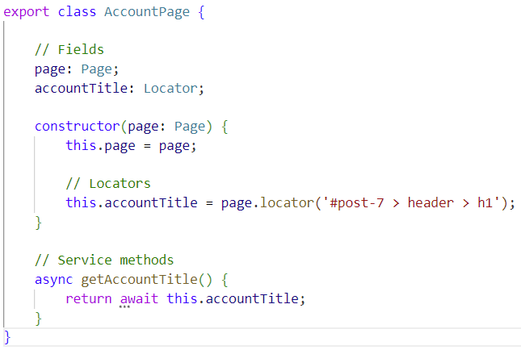
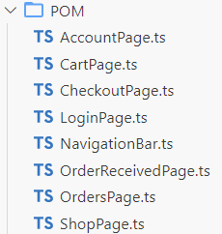
Design Pattern: Page Object Model (POM)
01
Locators are initialised within the constructor, ensuring that they are tied to the correct Page instance.
02
Service methods perform actions on the web page, such as entering text, clicking buttons, and verifying elements. These methods interact with the locators defined in the class, but not include any assertions.
03
The POM class focuses purely on page-specific logic. This separation enhances maintainability and allows the same class to be reused across multiple test cases.

Slide 8
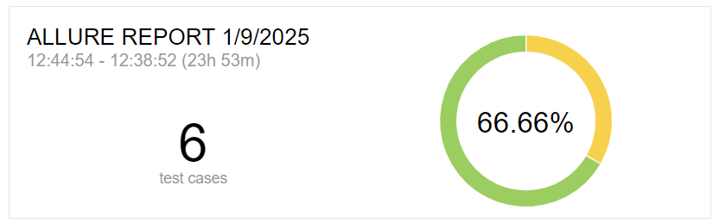
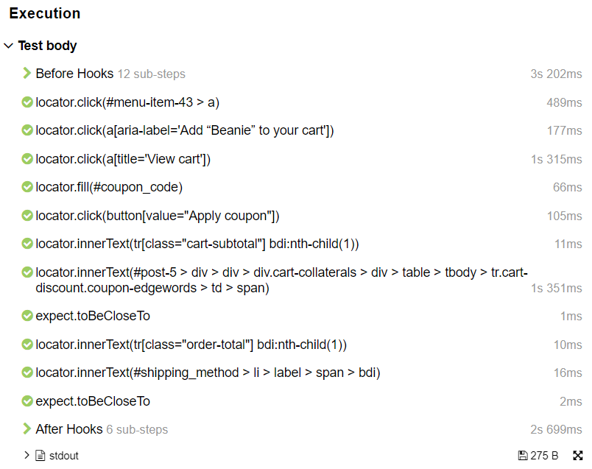
Allure Reporting
Clear and Detailed Test Reports
Integrates with various testing frameworks and CI/CD tools, offering a comprehensive view of test results, including detailed steps.
Visually Apealling
Easy-to-read reports, making it easier to understand test results.
Attachements
Supports adding screenshots, logs, and other attachments to test results for better debugging.
Notes:
"Reporting is a crucial aspect of testing, and we chose Allure Reporting for its clarity and versatility.
It provides detailed test reports that integrate seamlessly with CI/CD pipelines, giving us a comprehensive view of results.
The visually appealing interface makes it easier to understand test outcomes at a glance.
It supports attachments like screenshots and logs, making debugging straightforward. These features make Allure Reporting an invaluable part of our testing framework."

Slide 9
THANK YOU

